Slide 2
SIG-Windows
Michael Michael (SIG-Windows Chair) @michmike [GitHub]
Patrick Lang (SIG-Windows Chair) @patricklang [GitHub]

Slide 3
History
Alpha Release
Kubelet and kube-proxy running on windows Show the art of the possible despite limitations
Dec 2017 V1.9
March 2019 v1.14
Dec 2016 V1.5
Beta Release
Tremendous updates in functionality and CNI support
Stable Release
Support for adding Windows Server 2019 nodes to Kubernetes
Notes:
Major accomplishments

Slide 4

Updates
Stable release of Windows node with 1.14
Windows Server 2019 support
Significant advancements in code quality
Validation of end user scenarios
Alpha release of gMSA
Test Automation
Extensive end-user documentation
Kubernetes 1.14: Caturnetes

Slide 5
Networking Update
Networking topologies available
Overlay
Requires Windows Server 2019 with KB4489899
Win-overlay plugin available
Flannel vxlan support in alpha
Underlay - L2Bridge, L2Tunnel
win-bridge plugin available
Flannel host-gw support
Transparent – vSwitch extension
ovn-kubernetes
Policy
Calico
OVN
Notes:
Great reference
https://techcommunity.microsoft.com/t5/Networking-Blog/Introducing-Kubernetes-Overlay-Networking-for-Windows/ba-p/363082

Slide 6
Things to Consider
Read the documentation!
Where the container runs
Need a Windows Server node = Use NodeSelector
If you’re adding Windows and don’t already have nodeSelector on Linux deployments
Option 1 (preferred): Add a taint to Windows nodes, toleration to Windows deployments
Option 2: Update your Helm Charts and YAML files
Resource Consumption
Need higher limits (300Mb min) - need Windows background services per container
Kernel/User compatibility
Windows kernel major version should match (for now) – use versioned tags, not latest!
Build on Windows Server 2019 = must run on Windows Server 2019
Hyper-V isolation [alpha] can run older containers on a newer node
SLIDE
6

Slide 7
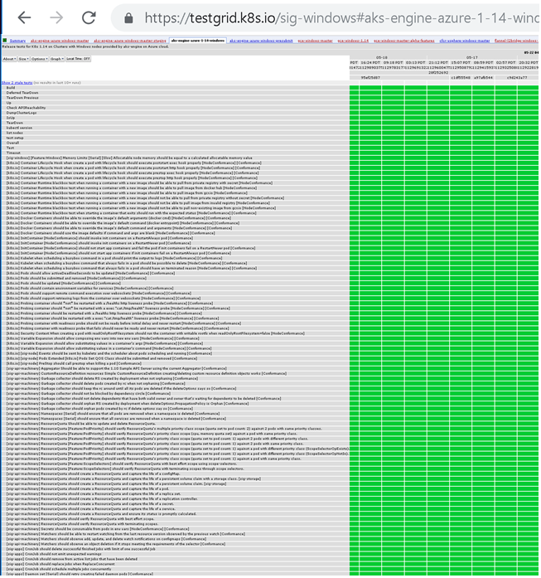
Testing Update
Windows node is now being tested in test grid across Azure, GCP and vSphere
Conformance tests (excluding LinuxOnly)
Windows specific tests
Tested 1.14
Ongoing dot release testing

Slide 8
Turnkey Solutions Available
Amazon EKS
Docker Enterprise
Google GKE
Huawei Cloud (CCE)
Microsoft AKS
Rancher
RedHat OpenShift
VMware/Pivotal Enterprise PKS

Slide 9
Future Plans

Slide 10
CRI-ContainerD
Aligned with Kubernetes goals and current Windows development
Improve compatibility: enable fixes to single file mapping
Be ready for dockershim deprecation when it happens
Reduced footprint and installation
Hyper-V isolation support
Future: Additional storage support
Future: Memory and CPU resource control
KEP outlines plan over multiple releases & work spans multiple projects
Kubernetes
ContainerD
CNI plugins
Notes:
Major Goals

Slide 11
1.15 Estimate
CRI-ContainerD (sig-node collaboration)
Kubeadm initial support (sig-cluster-lifecycle collaboration)
Continuing advancements in gMSA and Windows workload identity (sig-node/sig-api/sig-auth collaboration)
RunAsUserName enhancement
More CNIs and Storage plugins
→ Fix bugs and address customer issues/concerns
Notes:
Major Goals

Slide 12






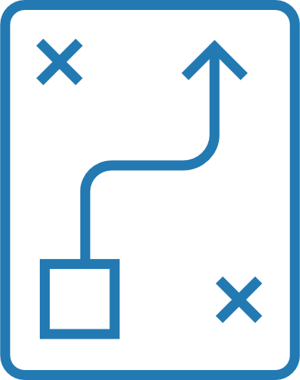





How to Contribute
End User
Contributor
Tech Lead
Contributing
Guide
1st Commit
Fix Bugs
Commits
Reviews
Release Plans
GitHub Issues
Document/Blog
Community Meetings
Member
Community Meetings
Presentations
Cross Group
Collaboration

Slide 13
Getting Started
Join our weekly meetings at 12.30pm Eastern
View recorded community meetings
Find bugs you can fix in our project board
Help us write additional documentation and user stories

Slide 14






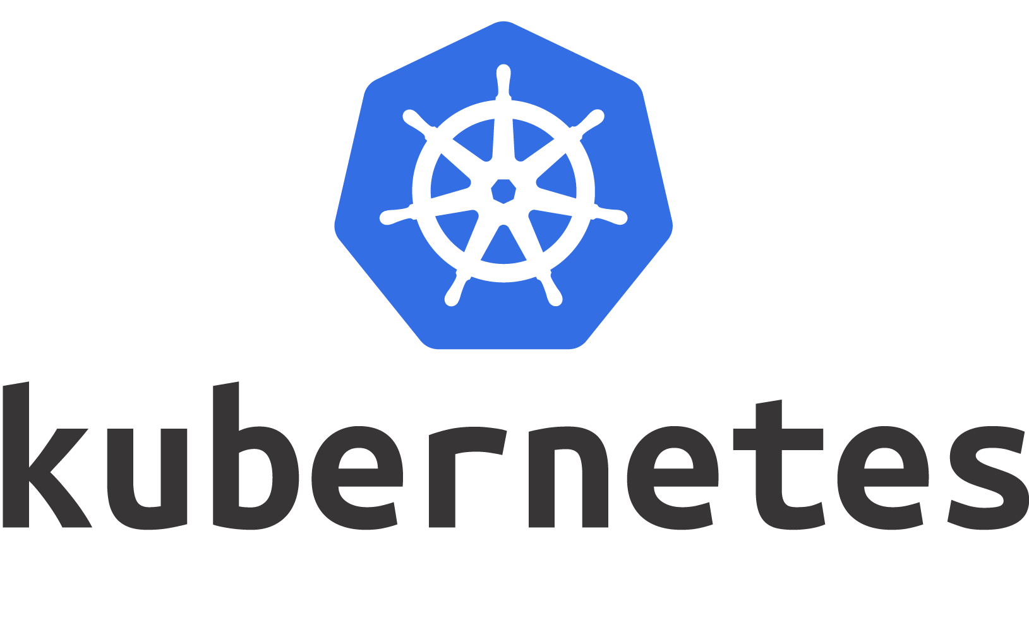
How to find us
https://groups.google.com/forum/#!forum/kubernetes-sig-windows
https://discuss.kubernetes.io/c/general-discussions/windows
#sig-windows
@m2
@patricklang
https://www.youtube.com/playlist?list=PL69nYSiGNLP2OH9InCcNkWNu2bl-gmIU4
https://github.com/kubernetes/community/tree/master/sig-windows
https://zoom.us/j/297282383
https://kubernetes.io/docs/setup/windows

Slide 15

Q&A

